Slide 1



Child development
Chapter 2: Cognitive development
How children’s thinking develops
© Hodder Education 2009

Slide 2
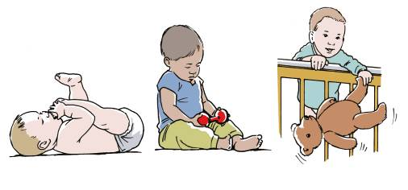
Piaget’s Theory 1
Constructivist assumptions
Babies start with simple schemas.
They learn new schemas by
  adaptation
  assimilation
  accommodation.
This is discovery learning.
© Hodder Education 2009

Slide 3
Piaget’s Theory 2
Learning is in cognitive stages
Sensorimotor stage (zero to two years)
  object permanence + research studies
Preoperational stage (two to seven years)
  animism; centration; egocentrism; + research studies
Concrete operational stage (seven to 11 years)
  logical thought; conservation; reversibility; + research studies
Formal operational stage (12 years +)
  abstract concepts + research studies
© Hodder Education 2009

Slide 4
Piaget’s Theory 3
Evaluation of:
his theory
  rigid stages; sequential shifts; ethnocentrism; discovery vs guidance; formal operational achievement
his research methods
  biased samples; standardisation, control; lack of clarity; biased assumptions
his overall work
  innovative approach; importance of cognitive development; clinical observations of children
his contribution to education
  active discovery; implications in the classroom
and learning
© Hodder Education 2009

Slide 5
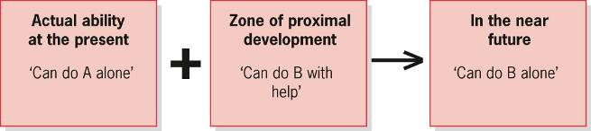
Vygotsky’s Theory 1
Assumptions
Learning through social experiences
  internalisation
  zone of proximal development
  Learning is a socio-cultural process.
© Hodder Education 2009

Slide 6

Vygotsky’s Theory 2
Scaffolding
Guided participation
Language
© Hodder Education 2009

Slide 7
Vygotsky’s Theory 3
His contribution to education
  language (supported by Bruner)
  peer tutoring
  collective argumentation
  community of enquiry
Evaluation of Vygotsky’s theory
  acceleration of cognitive development vs Piaget’s stages
  encouragement or discouragement of independent learning and initiative
  assumptions about adult participation
© Hodder Education 2009

Slide 8
Vygotsky and Piaget compared
Vygotsky | Piaget
Cognitive development is driven by social interaction and experience within a culture | Cognitive development is driven by the child’s inbuilt tendency to adapt to new experiences
Child learns through instruction and guidance | Child learns through active self-discovery
Cognitive development can be accelerated | Child will learn only when ready
The ability to use language is the key to cognitive development. Outward monologues direct thinking and later become internalised as thought | Language develops as a result of cognitive development. Outward monologues are meaningless and egocentric speech is incidental to thought
© Hodder Education 2009

Slide 9

Nativist explanations 1
Assumptions
We have innate cognitive structures.
Genetic predispositions for cognition
  e.g. grammar; perceptual abilities.
Learning is at least partly genetically determined.
Evaluation of the explanation
  challenges Piaget
  an incomplete explanation
© Hodder Education 2009

Slide 10
Information-processing approach 1
Assumptions
Brain processing is similar to computer processing
With key changes in how information is processed as the child develops
Cognitive, i.e. processing, efficiency increases because of:
  increased processing capacity and efficiency, and development of problem-solving rules and metacognition
Siegler’s research:
  overlapping waves
  increasingly complex cognitive strategies
© Hodder Education 2009

Slide 11

Information-processing approach 2
Evaluation
Siegler’s research:
  sequential change and importance of feedback and practice
  individual experience
  empirical methods
The information-processing approach to cognitive development:
  Separating components of cognition
  Numerous studies
  Applications to teaching
  Links with neurophysiology
© Hodder Education 2009

